Slide 1
CONTRACEPTIVES
Any technique used to prevent pregnancy.
Contraceptive methods involve one, or a combination of two or more, of the following:-
1) Abstinence
2) Providing a physical or chemical barrier to block the sperm from fertilising the ovum.
3) Preventing sperm or ovum production
4) Preventing implantation after fertilisation

Slide 2
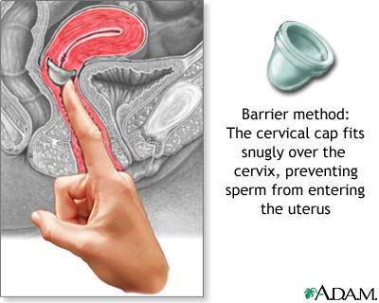
PHYSICAL BARRIER: CERVICAL CAP/ DIAPHRAGM
The cervical cap fits over the cervix to prevent sperm passage to uterus.
Cervical cap more reliable if used with chemical barriers (spermicides etc)
Requires costly surgery to insert but easily removed.

Slide 3
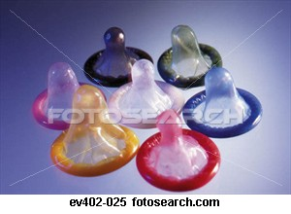
PHYSICAL BARRIER: CONDOMS
Condoms are rolled over the penis to catch sperm during ejaculation.
They help prevent STI's & are fairly cheap.
Occasionally they can be unreliable if they slip off or break.

Slide 4
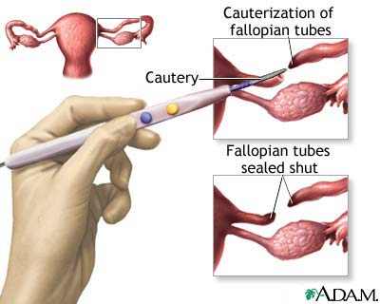
PHYSICAL BARRIER: TUBAL LIGATION
The oviducts are cut or sealed to prevent sperm reaching ovum.
The menstrual/ ovarian cycle continues & the endocrine system is not affected.
Very reliable & sometimes reversible
Costly operation

Slide 5
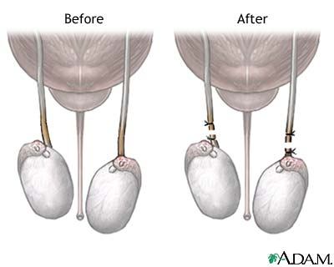
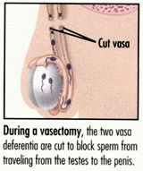
PHYSICAL BARRIER: VASECTOMY
Incisions in the vas deferens prevent sperm movement out of the testes.
Ejaculation of fluid still occurs & hormone levels aren't affected.
Very reliable
Requires costly surgery

Slide 6
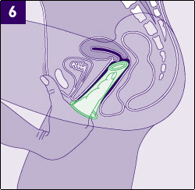
PHYSICAL BARRIER: FEMDOM
Put into the vagina prior to intercourse.
It is about 7 inches & made of polyurethane
Provides an impenetrable block to sperm movement.
Not as effective at preventing STI's as the male one.
Moderately reliable

Slide 7
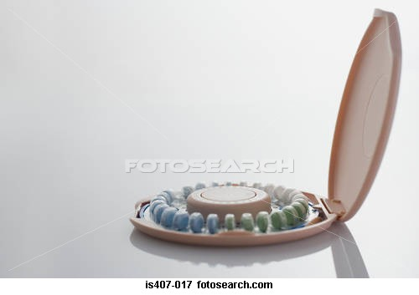
CHEMICAL BARRIERS: BIRTH CONTROL PILL
Two main types: oestrogen & progresterone based.
Oestrogen based prevents ovulation.
Progesterone based helps form a mucus plug at cervix- stops sperm.
Very reliable, improves acne & lessens menstrual cramps.

Slide 8
CHEMICAL BARRIERS: BIRTH CONTROL PILL
Side effects include:
*increased blood pressure
*nausea
*weight gain
*increased chance of stroke or blood clots
*decreased amount of breast milk
Can be injected to provide contraception for several (5?) months.

Slide 9
CHEMICAL BARRIERS: SPERMICIDES
Spermicides are chemicals that kill sperm.
They can come in jelly, foam or tablet form.
Spermicides can also create hostile mucus around the cervix to block the sperm.
They are not very reliable and for this reason should be used with other forms of contraceptive.

Slide 10
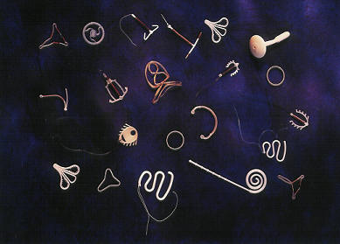
PHYSICAL BARRIER TO IMPLANTATION: INTRA- UTERINE- DEVICE (IUD)
A device containing hormones which is surgically inserted into the uterus.
Hormones alter the endometrial lining to prevent implantation after fertilisation.
The device itself also prevents implantation
Very reliable (1%)
Heavy bleeding & cramping during menstruation often occurs

Slide 11
“NATURAL” METHODS
Douching- washing out the vagina.
“Coitus interruptus”- male withdraws penis before ejaculation.
Rhythm method- the monitoring of temperature, vaginal secretions and/ or mucus to determine a “safe” period when an ovum isn't available to be fertilised.
These methods are highly unreliable!

